Slide 1
Enterprise Ad Promo Timeline
June 17, 2025

Slide 2
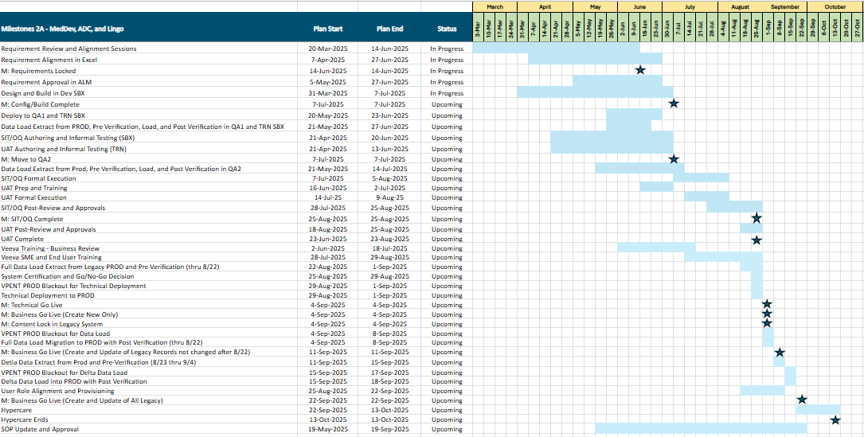
Enterprise Ad Promo - Wave 2A Timeline

Slide 3
Important Dates
Config/Build Complete – 7-Jul
Move to QA2 (Enterprise QA/UAT) – 7-Jul
SIT/OQ Formal Execution – 7-Jul to 5-Aug
UAT Formal Execution – 14-Jul to 9-Aug
UAT Post-Review and Approvals – 18-Aug to 25-Aug
UAT Complete – 25-Aug
Go-Live 4-Sep

